Slide 1
Heart Rate Monitor using Pulse Sensor
Vincent Tuason
Email: tuasov1@unlv.nevada.edu

Slide 2
AIM & ACCOMPLISHMENT
AIM:
Read an person’s heart rate
Count the number of beats
Output pulse onto UART terminal
Output BPM (Beats per minute) onto UART terminal
Transmit and display Raw Pulse graph, raw pulse, and BPM on the host.
ACCOMPLISHMENT
Successfully read a person’s heart rate
Successful transmission of all data to the host via Bluetooth

Slide 3
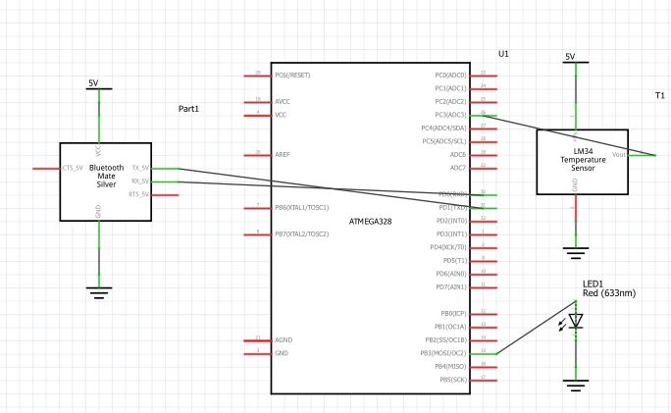
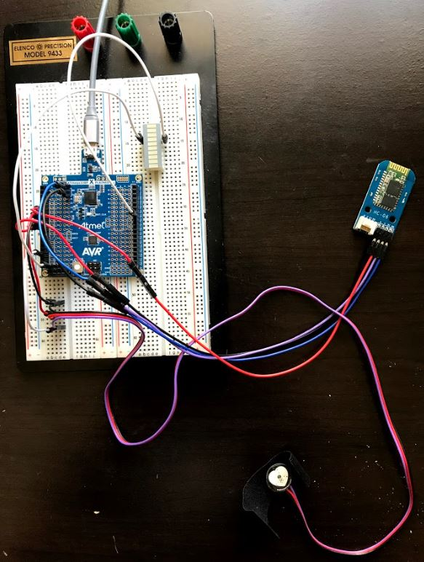
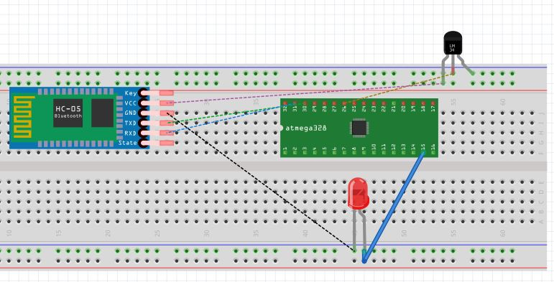
SCHEMATICS
Complete schematics

Slide 4
DESIGN STAGES
Components
AVR ATMEGA328p Xplained Mini
Pulse Sensor
HC06 Serial Bluetooth Brick
LED Block
Interfaces
Atmega328p – Pulse Sensor using ADC
Atmega328p – HC06 Serial Bluetooth Brick using UART
HOSTs
Laptop

Slide 5
CODE DEVELOPMENT
Initialization
Initialize ADC
Initialize USART
Data Collection
Set up a timer to check for a pulse every second
Once a pulse is read, it is checked
Once pulse is verified, increment beat counter , blink the LED
Do this for 60 seconds, then print BPM (Beats per Minute)
Reset timers, reset time variable, reset BPM
6. Repeat

Slide 6
CODE DEVELOPMENT
Networking/Visualization
Pair the HC06 Bluetooth Module with Host Bluetooth connection Default Pin code = 1234 Name: itead
Open two windows of Atmel studio
One window = Code One window = empty
Open data visualizer on the Code window and connect to mEDBG in the serial port control panel
Open data visualizer on the empty window and connect to Standard serial over Bluetooth link in the serial port control panel
Create graphs for each data visualizers and click connect

Slide 7
Code Development
Initialize ADC and USART
Set up timer and poll for a pulse
Read and check the Pulse value. Compare it to threshold
If valid, increment BPM, print raw pulse and BPM(after 1 min).
Reset timer, repeat

Slide 8
DEMO SNAPSHOT/VIDEO
Just Provide Links
Demonstration and PowerPoint with voice:
https://www.youtube.com/watch?v=ZeoMACo3YGY&index=0&list=PLV6KcqcI7x8xjTS0bIZWyFhFyl_kPGgaU

